Slide 1


Dr. D. Y. Patil Pratishthan's Institute for Advanced Computing and Software Development
DAY 5C Programming

Slide 2
Day 4
Today We discuss the following topics:-
--
--
--
--Type Casting

Slide 3
C Functions
In c, we can divide a large program into the basic building blocks known as function. The function contains the set of programming statements enclosed by {}. A function can be called multiple times to provide reusability and modularity to the C program. In other words, we can say that the collection of functions creates a program. The function is also known as procedure or subroutine in other programming languages.

Slide 4
Three program elements involved in using a Function:-
There are three aspects of a C function.
Function declaration /Function prototype:-A function must be declared globally in a c program to tell the compiler about the function name, function parameters, and return type.
Function call :-Function can be called from anywhere in the program. The parameter list must not differ in function calling and function declaration. We must pass the same number of functions as it is declared in the function declaration.
Function definition :-It contains the actual statements which are to be executed. It is the most important aspect to which the control comes when the function is called. Here, we must notice that only one value can be returned from the function.

Slide 5
Syntax:-
C function aspects | Syntax
1 | Function declaration | return_type function_name (argument list);
2 | Function call | function_name (argument_list)
3 | Function definition | return_type function_name (argument list) {function body;}
return_type function_name(data_type parameter...)
{
//code to be executed
}

Slide 6
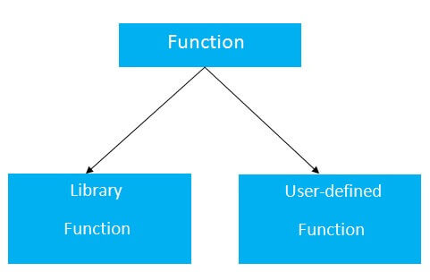
Types of Functions
There are two types of functions in C programming:
Library Functions: are the functions which are declared in the C header files such as scanf(), printf(), gets(), puts(), ceil(), floor() etc.
User-defined functions: are the functions which are created by the C programmer, so that he/she can use it many times. It reduces the complexity of a big program and optimizes the code

Slide 7
Return Value
A C function may or may not return a value from the function. If you don't have to return any value from the function, use void for the return type.
If you want to return any value from the function, you need
to use any data type such as int, long, char, etc. The return
type depends on the value to be returned from the function.
Example without return value:
void hello(){
printf("hello c");
}
with return value:
int get(){
return 10;
}
OR
float get(){
return 10.2;
}

Slide 8
Different aspects of function calling
A function may or may not accept any argument. It may or may not return any value. Based on these facts, There are four different aspects of function calls.
function without arguments and without return value
function without arguments and with return value
function with arguments and without return value
function with arguments and with return value

Slide 9
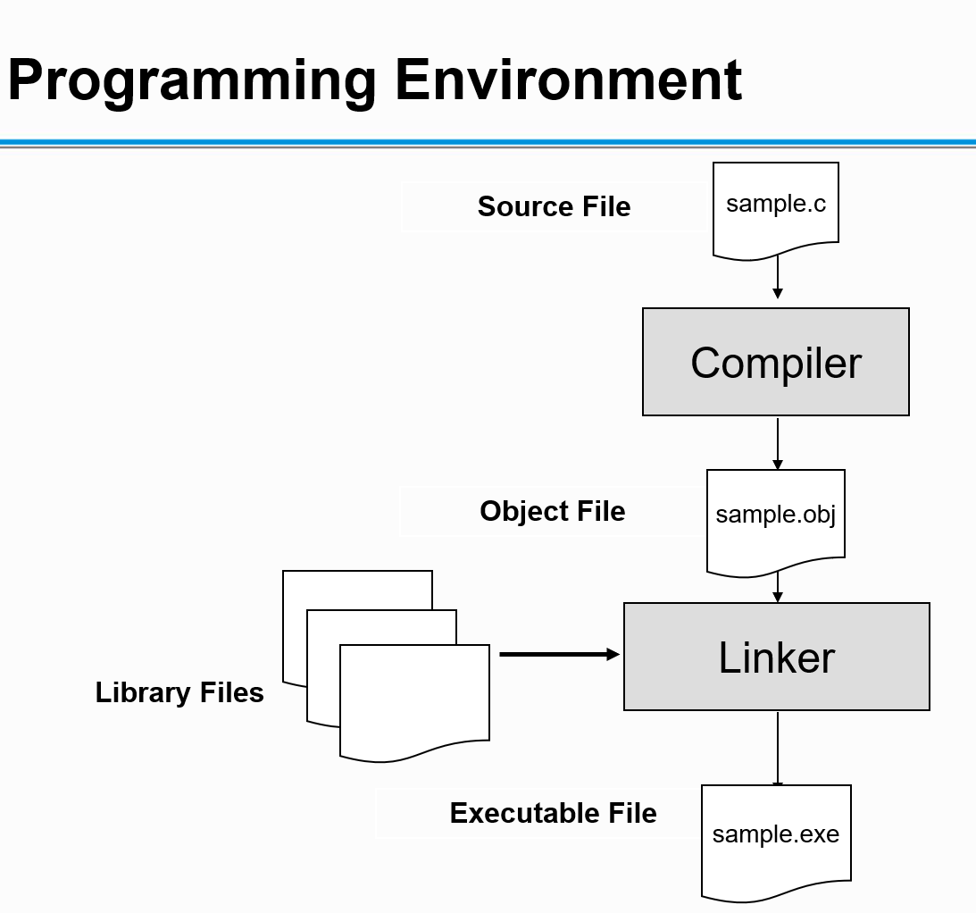

Slide 10
Types Of Error
Syntax Error:-
Statement missing
Unknown symbol
Logical Errors:-
Counter not incremented in the while loop
Wrong Expression
Runtime Errors:-
Division by zero
DMA failed
Linker Errors:-
Function definition missing

Slide 11
C Pointers
The pointer in C language is a variable which stores the address of another variable. This variable can be of type int, char, array, function, or any other pointer. The size of the pointer depends on the architecture. However, in 32-bit architecture the size of a pointer is 2 byte.
int n = 10;
int* p = &n; // Variable p of type pointer is pointing to the address of the variable n of type integer
Declaring a pointer
The pointer in c language can be declared using * (asterisk symbol). It is also known as indirection pointer used to dereference a pointer.
int *a;//pointer to int
char *c;//pointer to char

Slide 12
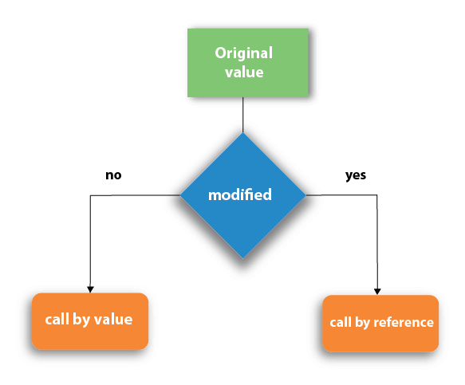
Call by value and Call by Address in C
There are two methods to pass the data into the function in C language, i.e., call by value and call by Address.

Slide 13
Call by value in C
In call by value method, the value of the actual parameters is copied into the formal parameters. In other words, we can say that the value of the variable is used in the function call in the call by value method.
In call by value method, we can not modify the value of the actual parameter by the formal parameter.
In call by value, different memory is allocated for actual and formal parameters since the value of the actual parameter is copied into the formal parameter.
The actual parameter is the argument which is used in the function call whereas formal parameter is the argument which is used in the function definition.

Slide 14
Call by Address in C
In call by address, the address of the variable is passed into the function call as the actual parameter.
The value of the actual parameters can be modified by changing the formal parameters since the address of the actual parameters is passed.
In call by address, the memory allocation is similar for both formal parameters and actual parameters. All the operations in the function are performed on the value stored at the address of the actual parameters, and the modified value gets stored at the same address.

Slide 15
Recursion in C
Recursion is the process which comes into existence when a function calls a copy of itself to work on a smaller problem. Any function which calls itself is called recursive function, and such function calls are called recursive calls. Recursion involves several numbers of recursive calls. However, it is important to impose a termination condition of recursion. Recursion code is shorter than iterative code however it is difficult to understand.
Recursion cannot be applied to all the problem, but it is more useful for the tasks that can be defined in terms of similar subtasks. For Example, recursion may be applied to sorting, searching, and traversal problems.
Generally, iterative solutions are more efficient than recursion since function call is always overhead. Any problem that can be solved recursively, can also be solved iteratively. However, some problems are best suited to be solved by the recursion, for example, tower of Hanoi, Fibonacci series, factorial finding, etc.

Slide 16
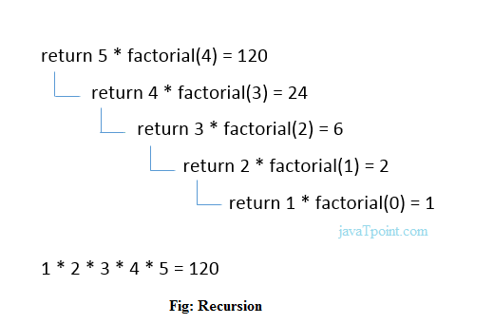
Recursion in C

